Slide 1
Python plots with matplotlib

Slide 2
Python packages required
Pandas
Numpy
matplotlib
Geopanda

Slide 3
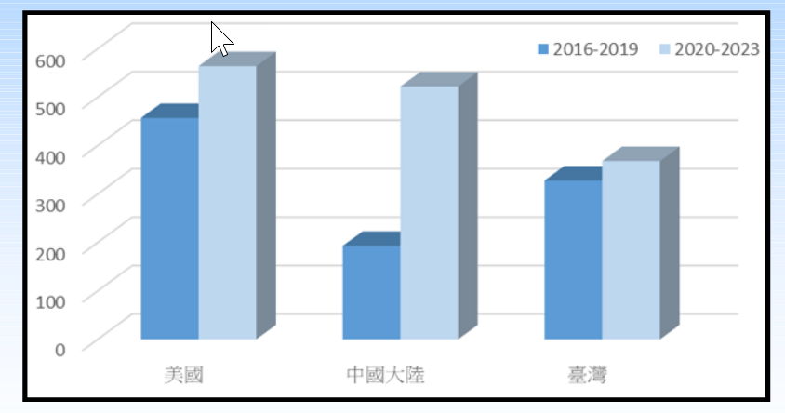
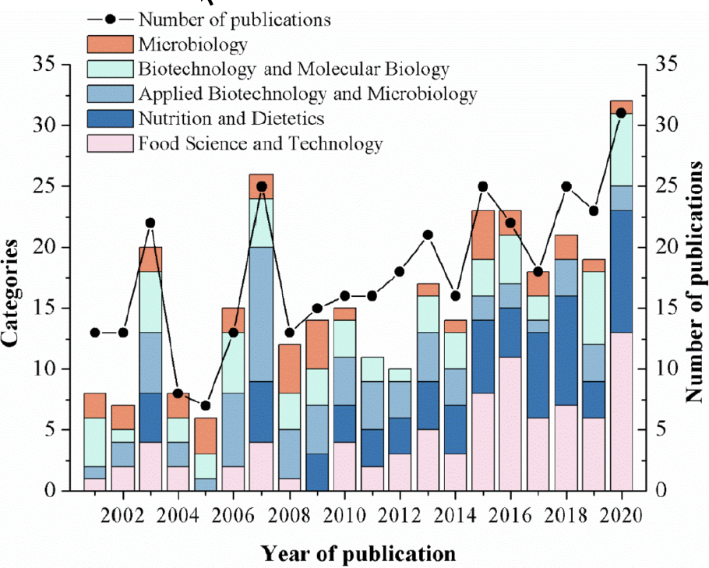
Plot of the time trend: stacked bar graphs
Period Pattern
Annual Pattern

Slide 4
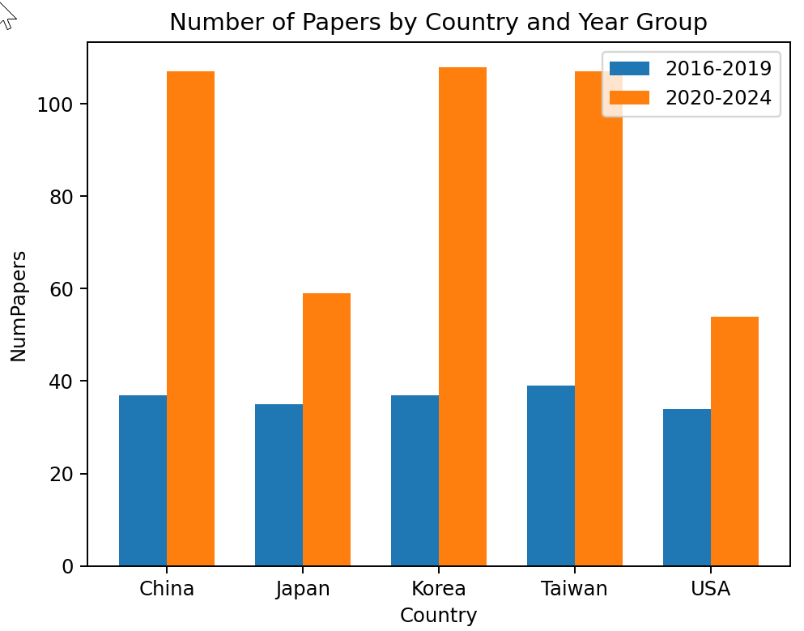
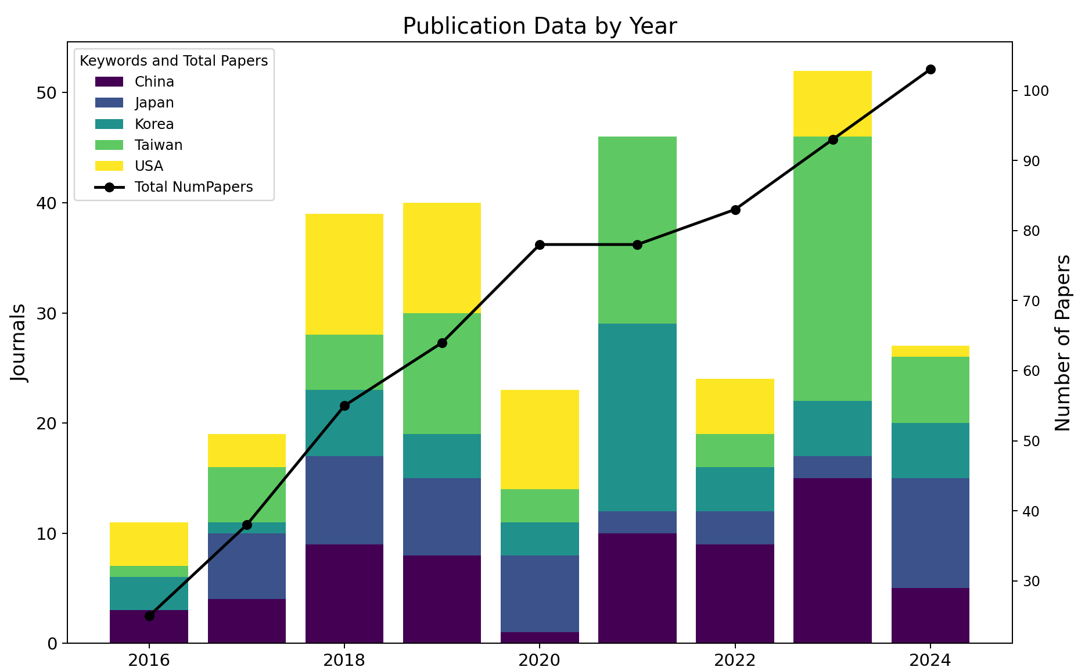
gendata_keywordXyear.py, keyword_year_stacked_bar.py

Slide 5
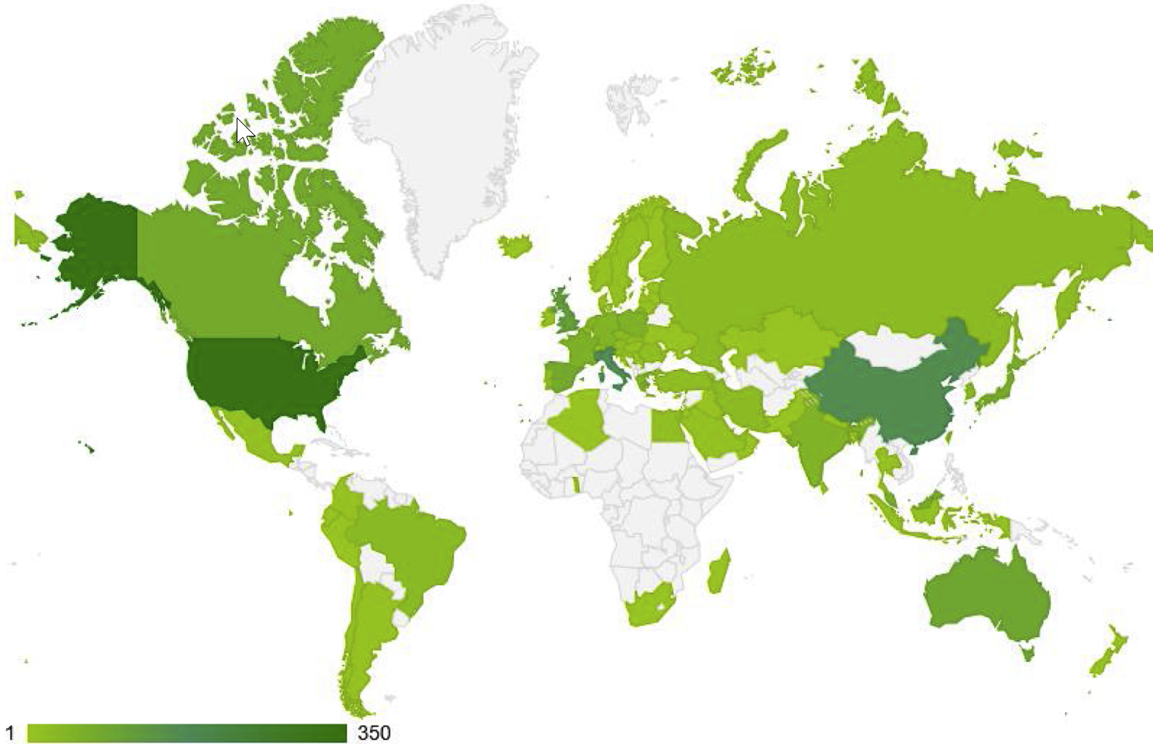
Example of Geographic Mapping
https://www.sciencedirect.com/science/article/pii/S2210670720308258

Slide 6
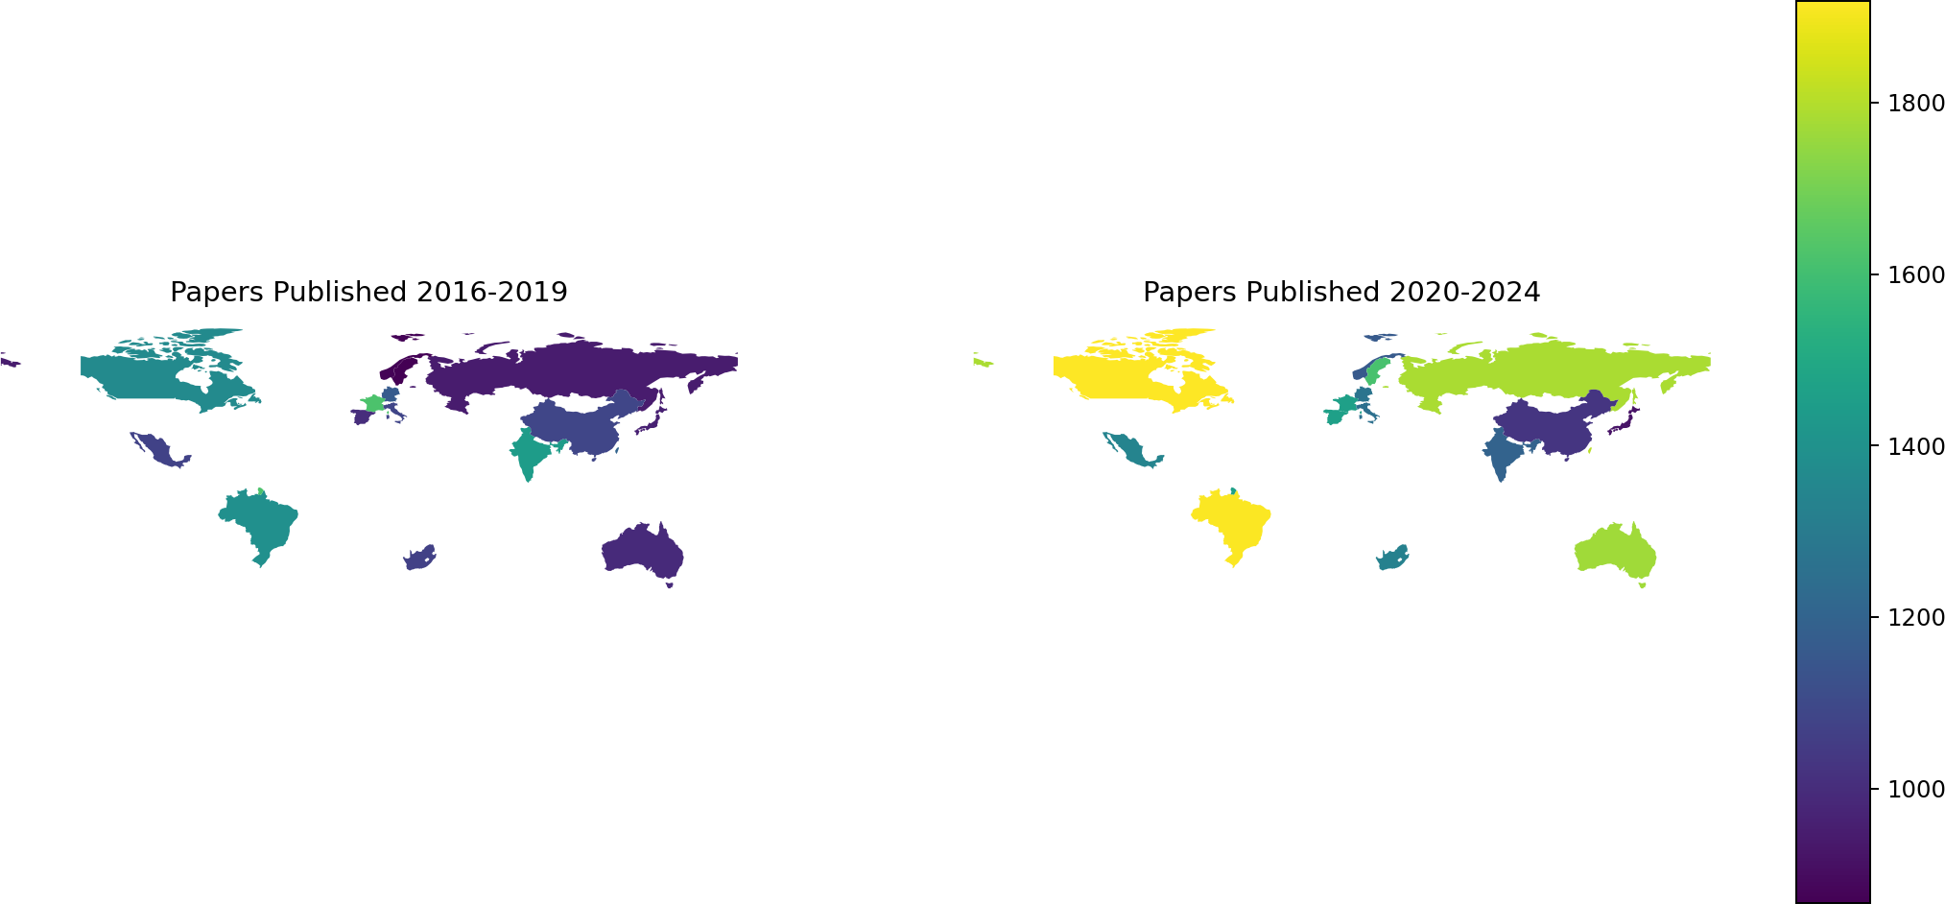
gendata_20countryXyear.py, worldmap_countryXperiod.py

Slide 7
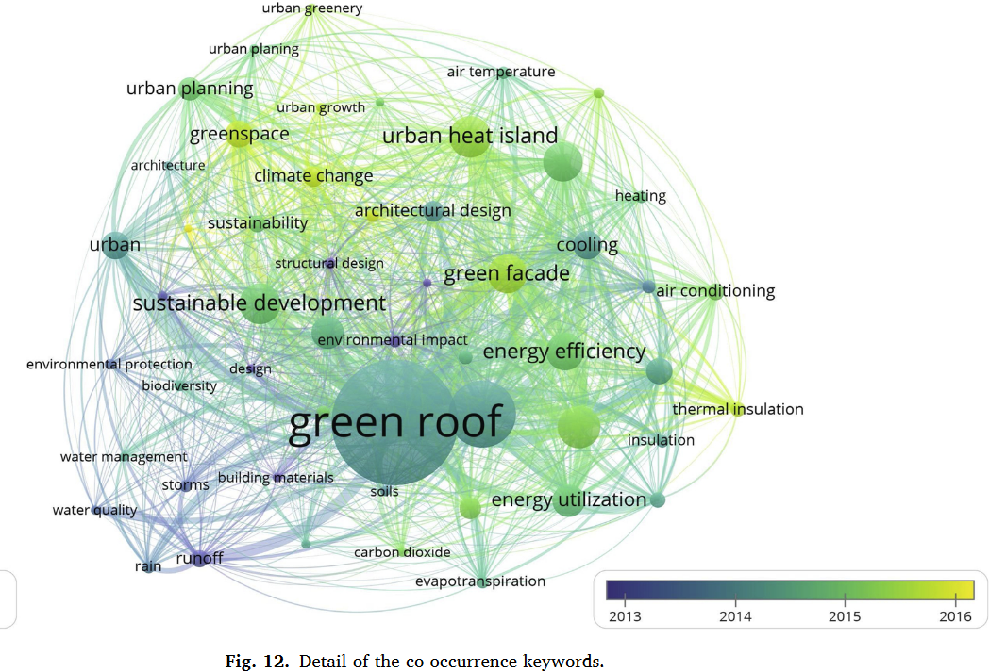
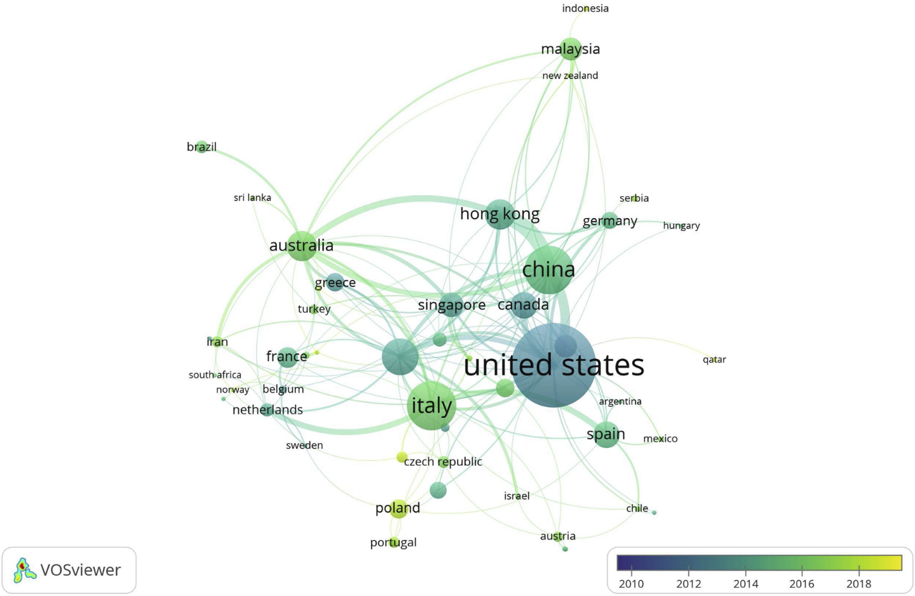
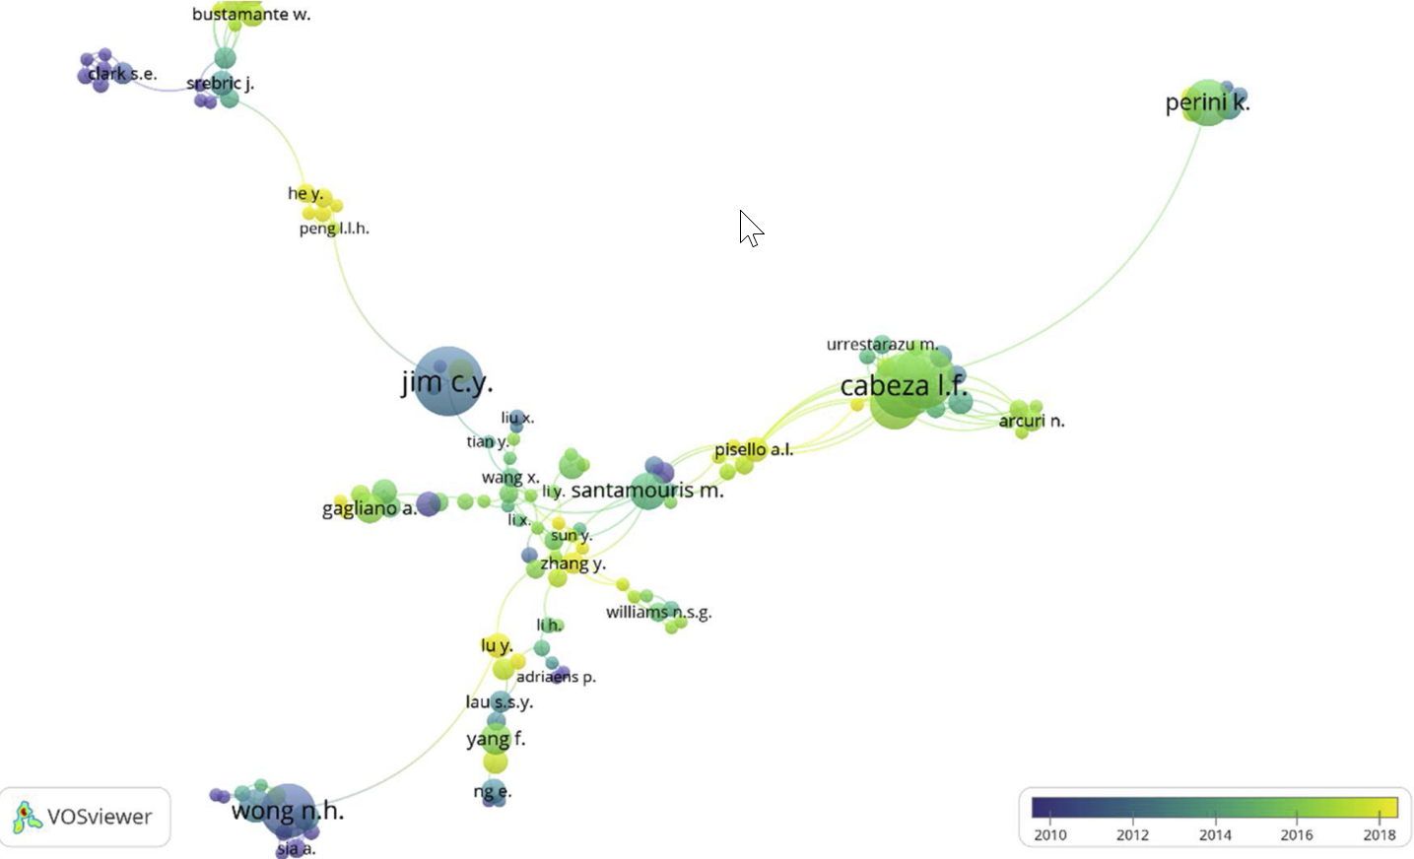
Network Analysis: Keywords, Countries, or Authors
keywords
Countries
Authors
https://www.sciencedirect.com/science/article/pii/S2210670720308258

Slide 8
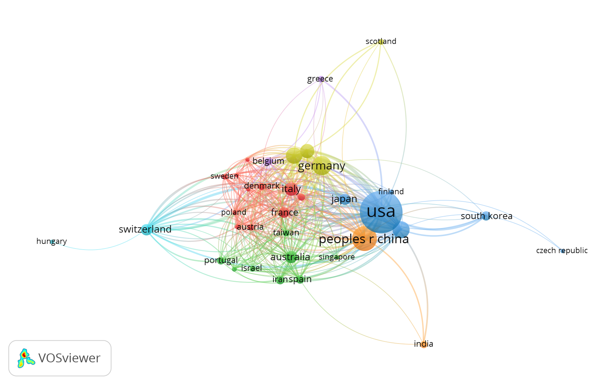
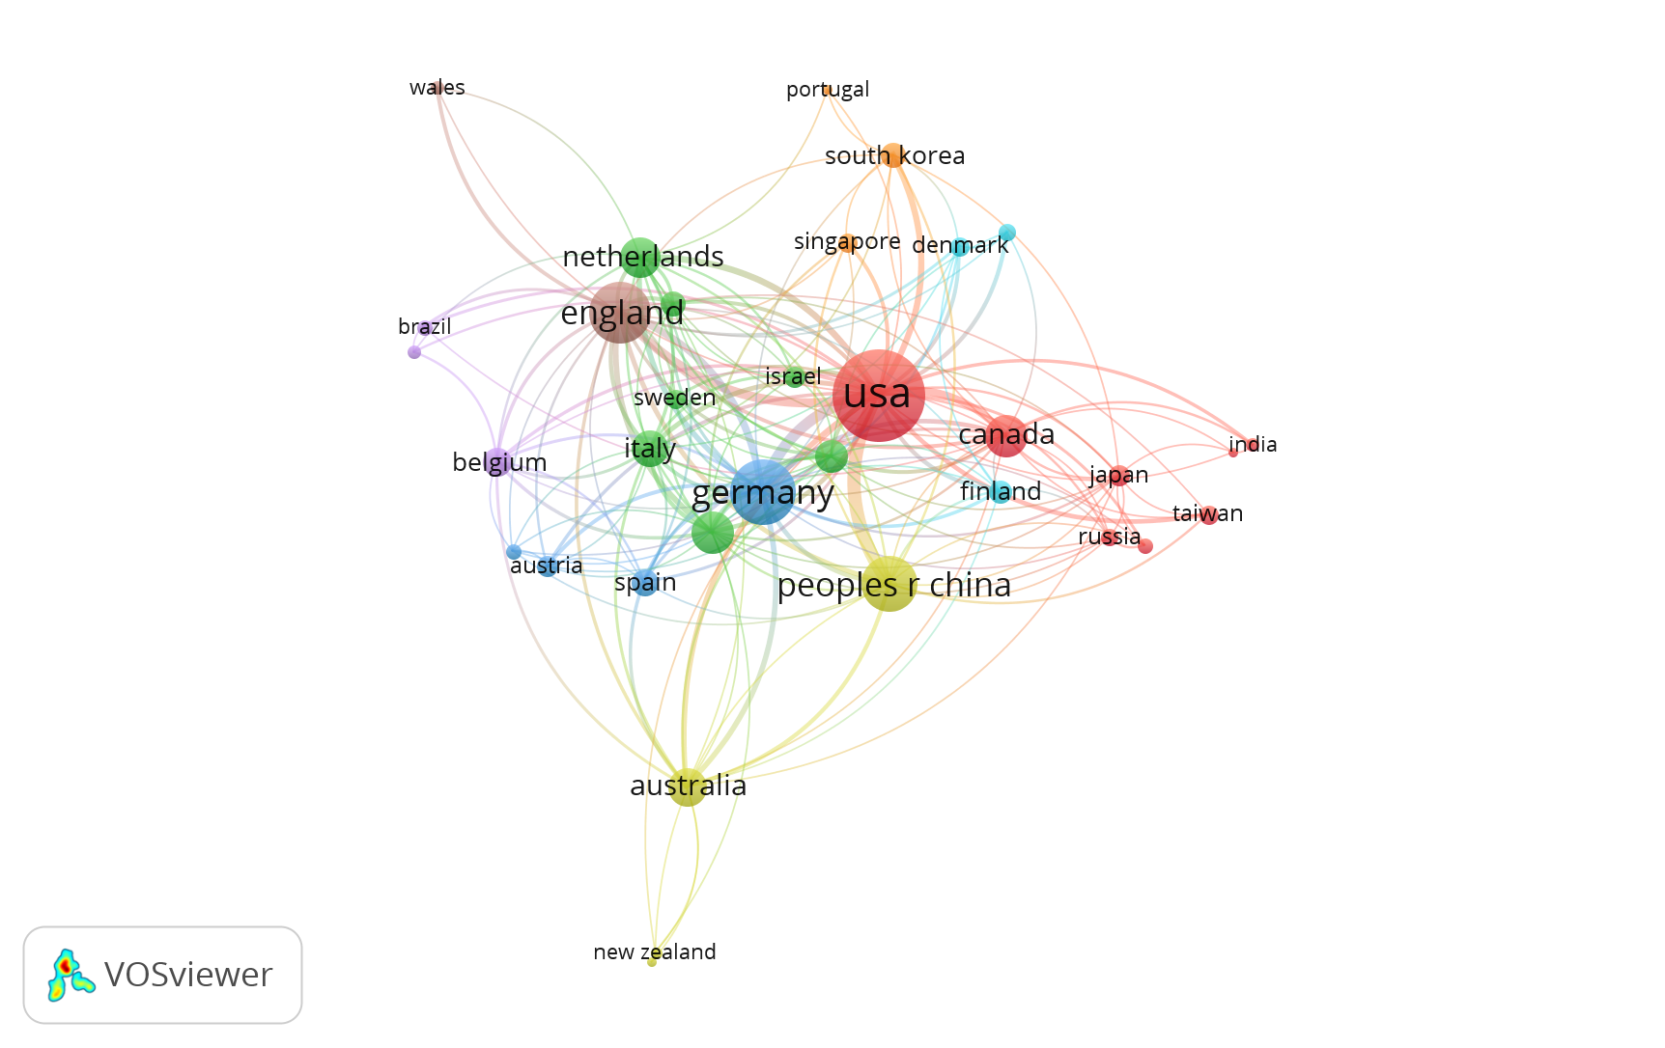
VOSviewer https://www.vosviewer.com/download
2016-2019
2020-2024

Slide 9
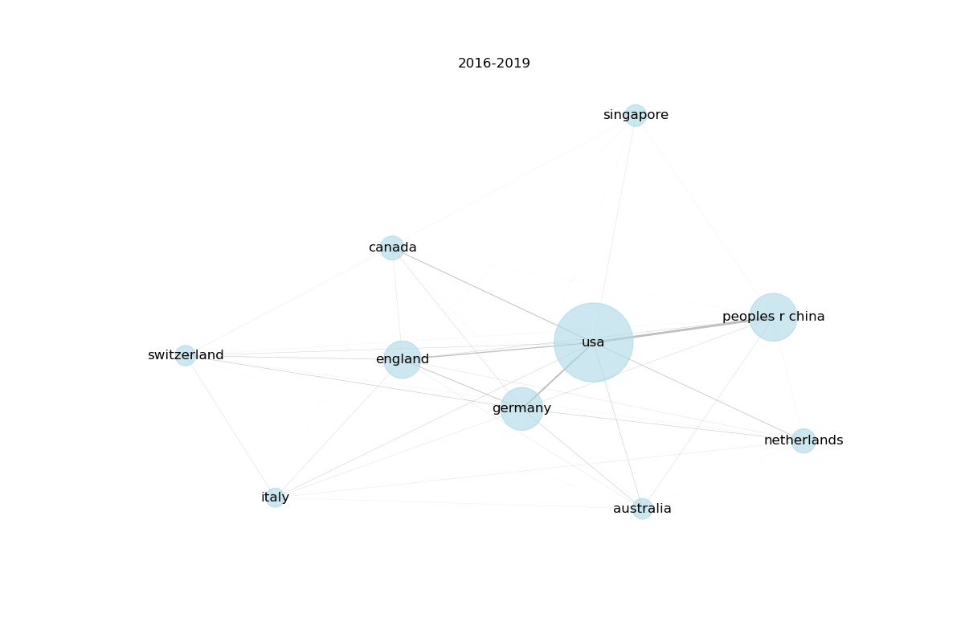
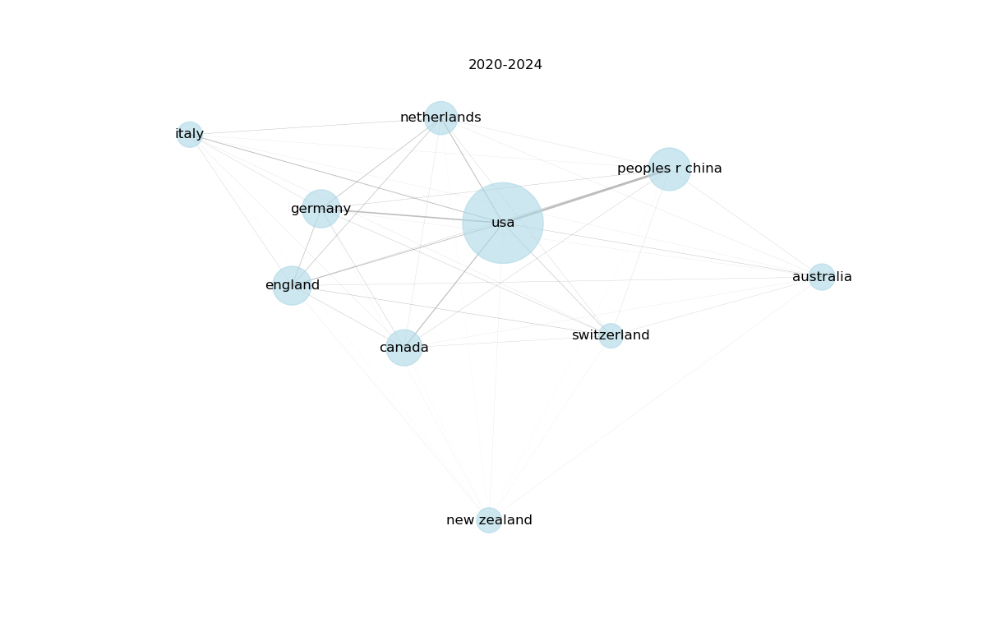
Simplified network
map_wos_fMRI_2016-2019_n1000.txt, map_wos_fMRI_2020-2024_n1000.txt
network_wos_fMRI_2016-2019_n1000.txt, network_wos_fMRI_2020-2024_n1000.txt;
vos_network_ana.py

Slide 10
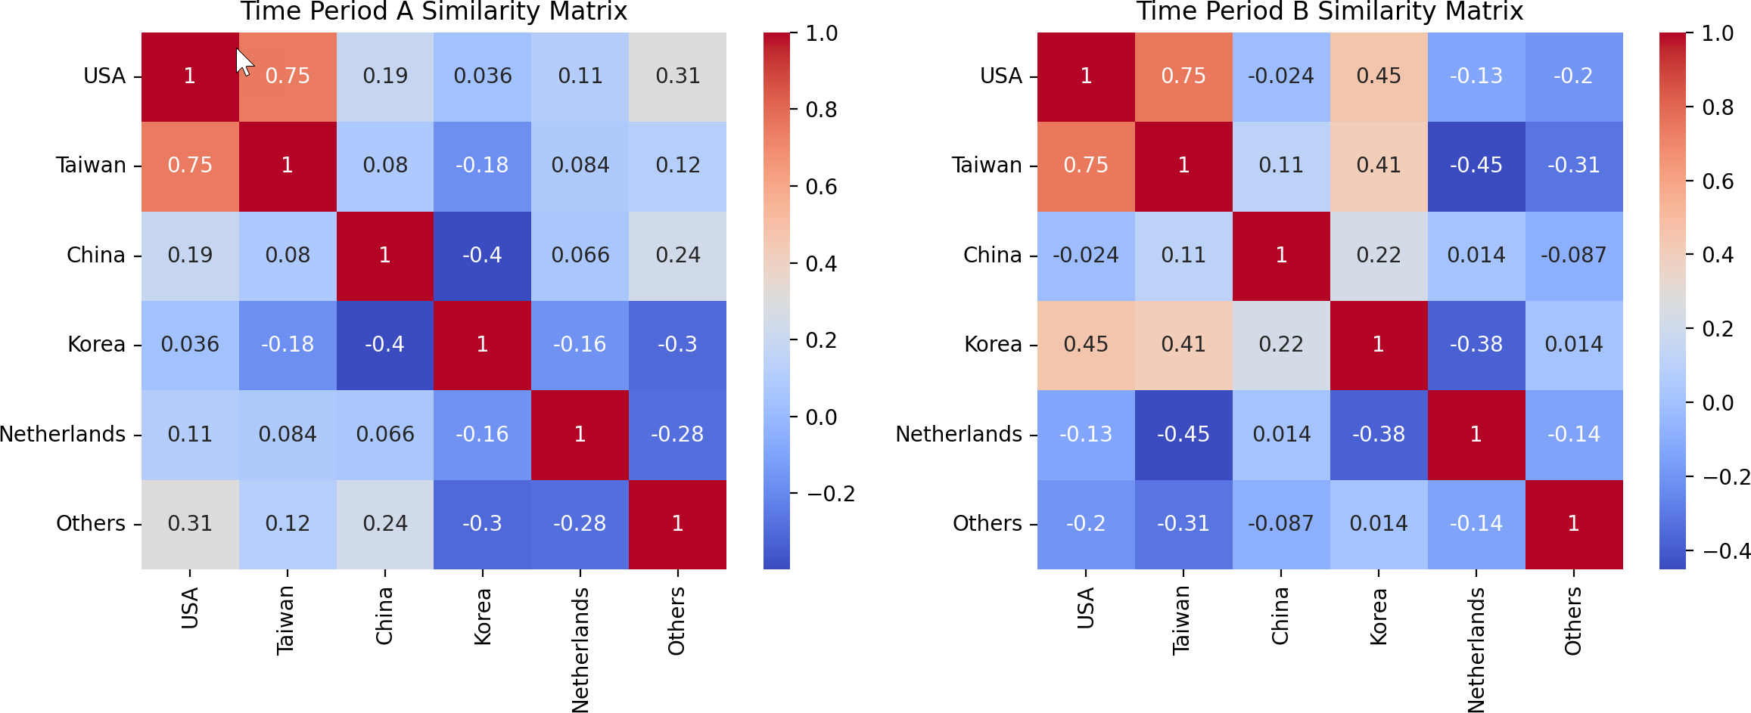
Correlation among Countries in Two Time Periods

Slide 11
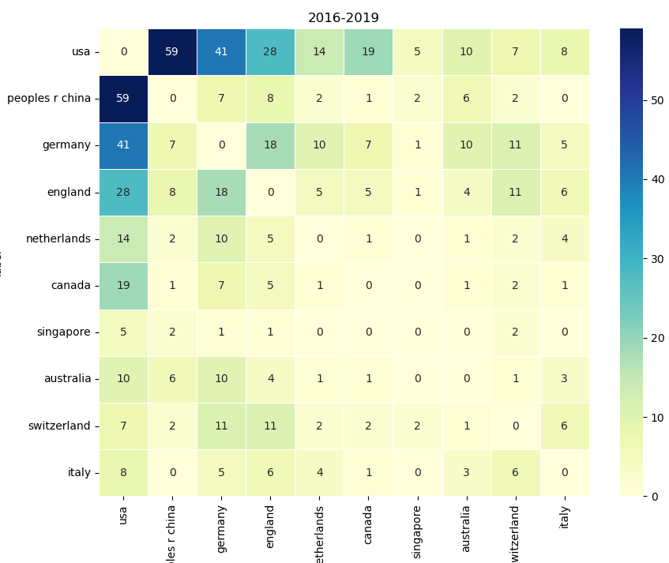
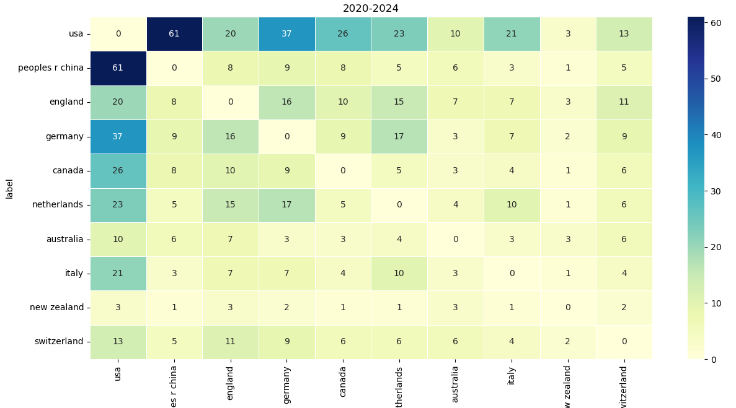
Heatmap based on network strength
map_wos_fMRI_2016-2019_n1000.txt, map_wos_fMRI_2020-2024_n1000.txt
network_wos_fMRI_2016-2019_n1000.txt, network_wos_fMRI_2020-2024_n1000.txt;
vos_network_ana.py

Slide 12
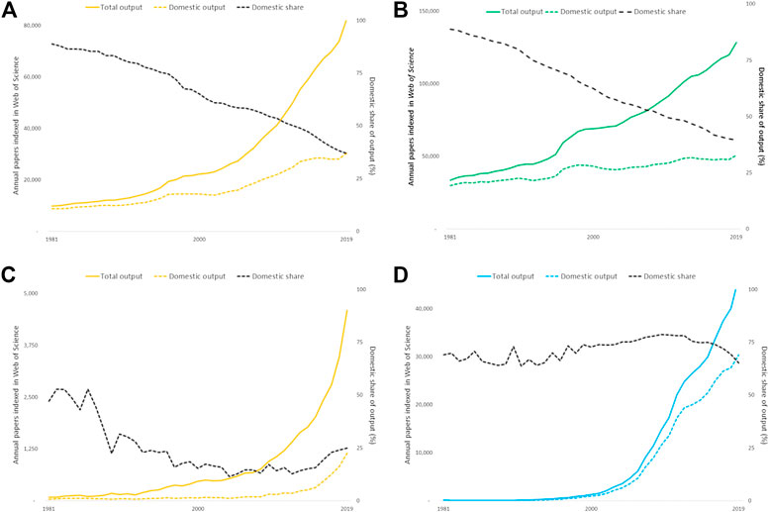
Trends in International vs. Domestic Research
Large research economies (Australia and Germany:
Almost all increase in annual publication counts can be accounted for by output shared with one or more collaborating countries whereas the domestic research output (with no international co-authors) has plateaued.
Smaller research economies (Indonesia & Iran):
risen more steeply but the profile of international collaboration is less consistent.
https://www.frontiersin.org/articles/10.3389/frma.2020.628703/full

